Slide 1
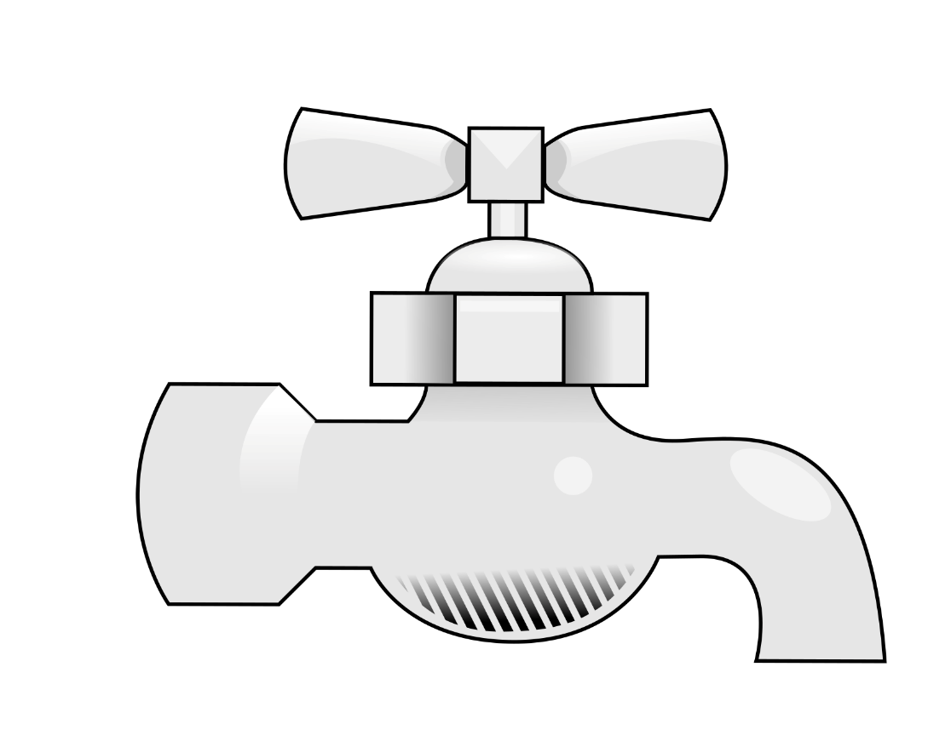

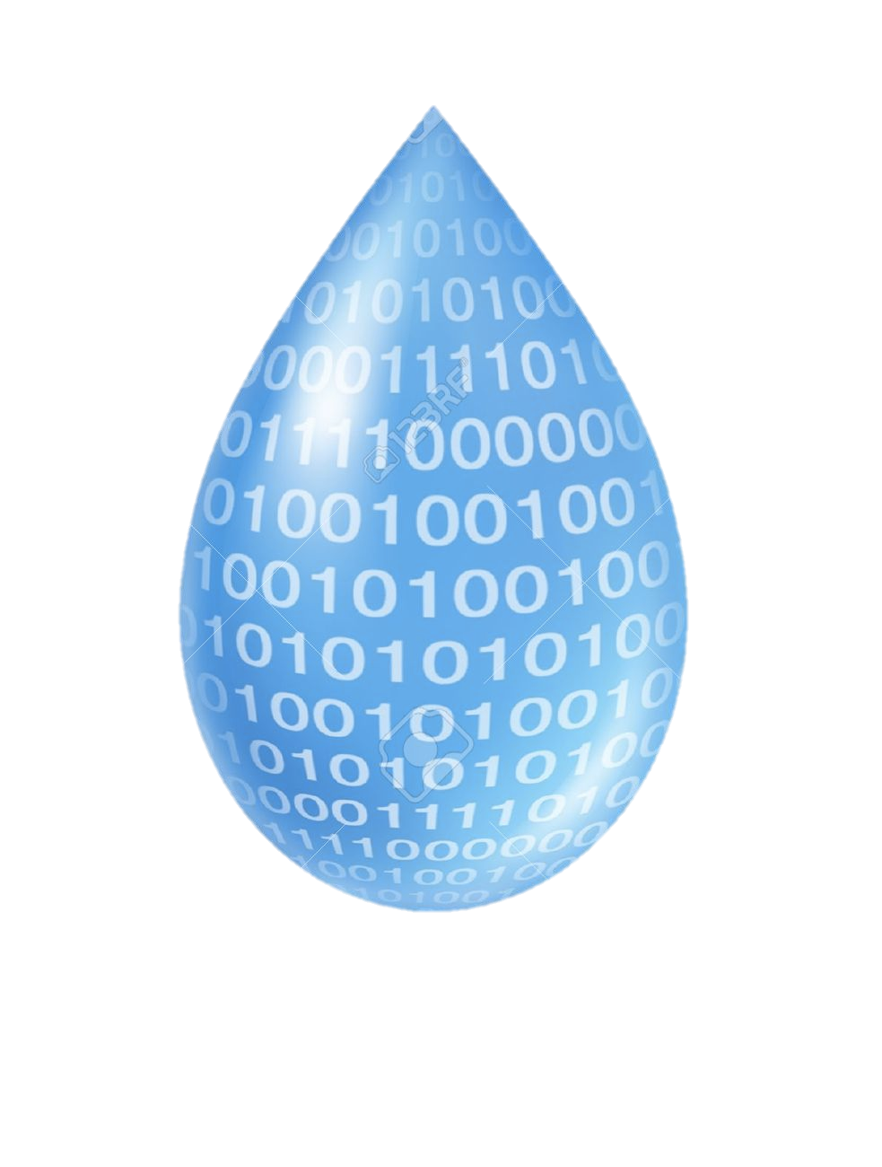
A Segmentation of Water Consumption with Apache Spark
Diego García
@d1eg0_garc1a
2016-06-07

Slide 2

Who am I?
M.S. in Computer Science (UIB) 2003/2009 M.S. in Automatics and Robotics (UPC) 2009/2010
Research Support at CS2AC UPC 2010/2014
Industrial PhD at Aigües de Barcelona & UPC 2014/2017?

Slide 3



Industrial PhD
Time: 3 years program (Generalitat de Catalunya)
Goal: improving university and industry synergies
+
Specific Research Center (CER) “Monitoring, Safety and Automatic Control” (CS2AC-UPC)

Slide 4
Water Consumption

Slide 5


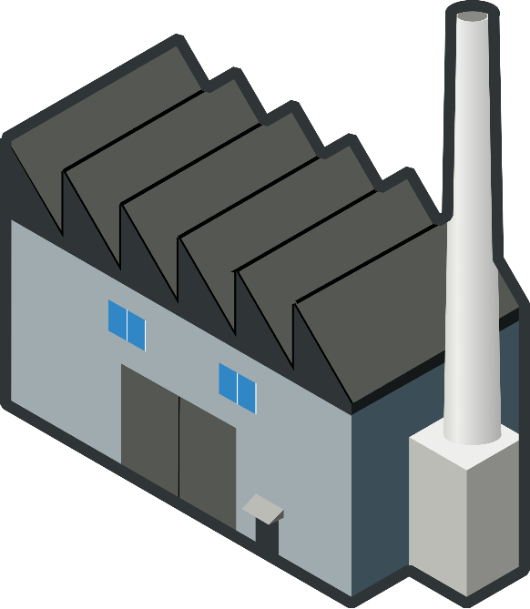
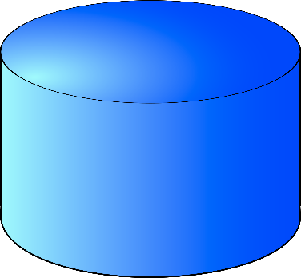

Urban Water Cycle
BUSINESS
INDUSTRY
DRINKING WATER
RESERVOIR
RIVER
RESIDENTS
WATER TREATMENT PLANT
CAUTION: THIS IS AN OVERSIMPLIFICATION

Slide 6




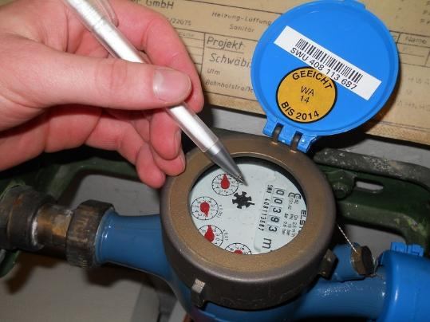
Conventional Meter Reading
ROUTES
DATA CENTER
Frequency: 1 reading/3 months

Slide 7



Automatic Meter Reading (AMR)
DATA CENTER
CONCENTRATOR
Frequency: 1 reading/1 hour

Slide 8


Apache Spark data pipeline
D. Garcia Valverde, D. González Vidal, J. Quevedo Casin, V. Puig Cayuela, and J. Saludes Closa, “Water demand estimation and outlier detection from smart meter data using classification and Big Data methods,” New Dev. IT Water Conf., pp. 1–8, 2015.

Slide 9
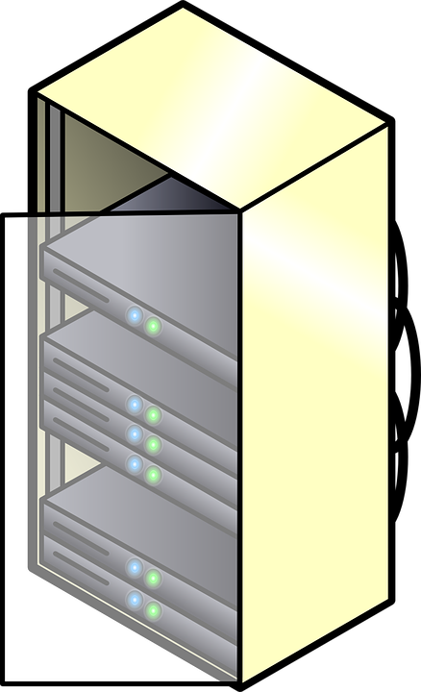

Why Spark?

Slide 10





Data pipeline
Storage
HDFS
Processing
MLlib
Results
Hadoop
Spark

Slide 11

Storage
Hadoop Distributed File System (HDFS)
CSV file with 14GigaBytes of AMR readings
(sensor id: string, timestamp: date_time, value: long)
50.000 water meters
2 years of data
~876 millions of rows
50.000 water meters x 2 years x 365 days x 24 hours/day

Slide 12
Processing
Preprocessing
Regular sampling
Filtering
Statistics
Outliers
Feature space
Weekly patterns
Unsupervised clustering
k-means

Slide 13
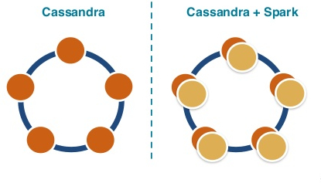
Apache Cassandra
NoSQL: hybrid between key-value and column-oriented
Open-source.
Fault-tolerant: distributed and replicated.
No master-slave. Hence, no single point of failure.
Denormalize.
import com.datastax.spark.connector._
stats:RDD[Type]
stats.saveToCassandra(“mykeyspace”, “stats”,SomeColumns(“id”, “max”, “min”,…))

Slide 14

Preprocessing
Resilient
Distributed
Dataset
Parse raw data (id, time stamp, value)
Regular time sampling [9:53,10:57,12:03] to [10:00, 11:00, 12:00]
Convert liters to liters/hour (differences)
Descriptive statistics (max, min, average, variance, sum, data rate)
$$data rate= \frac{\# readings}{\# total readings}×100$$
case class AmrReading( sensorid:String, date:DateTime, value:Double)
RDD[AmrReading]
scala> import breeze.interpolation._
scala> val x = DenseVector(0.4, 1.3, 2.1, 3.2)
scala> val y = DenseVector(2.0, 4.0, 8.0, 5.0)
scala> val f = LinearInterpolator(x, y)
scala> f(DenseVector(0.0, 1.0, 2.0, 3.0,…))
RDD[(id, ts, value)]
RDD[(id, max,min,avg…)]

Slide 15

Filtering
Goal: avoid empty houses and not representative consumers
$$data rate>70\%$$
$$average>0 l/h$$

Slide 16
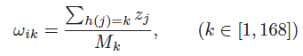
Feature space
The feature vector for a given smart meter i is
where each component k is given by
where M_{k} is the number of observations that satisfies h(j) = k and h(j) returns the hour of the week of the datum’s timestamp j.

Slide 17
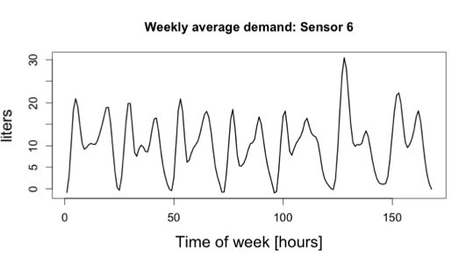
Feature space

Slide 18
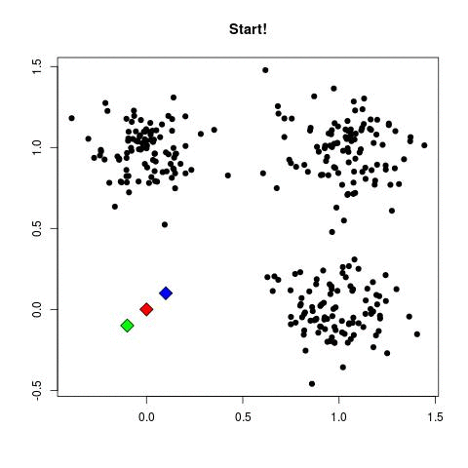


Unsupervised clustering
K-means
Inputs:
N feature vectors $x_{n}$
Number of clusters K
Algorithm
Initialize centroids $μ_{k}$
Update memberships $r_{nk}$
Update centroids $μ_{k}$
$$r_{nk}=\left\{\begin{aligned}1, k=\arg{\min{\{{||x_{n}−μ_{k}||}_{2}^{2}\}}} \\ 0, otherwise \end{aligned}\right.$$
Source: https://www.projectrhea.org

Slide 19

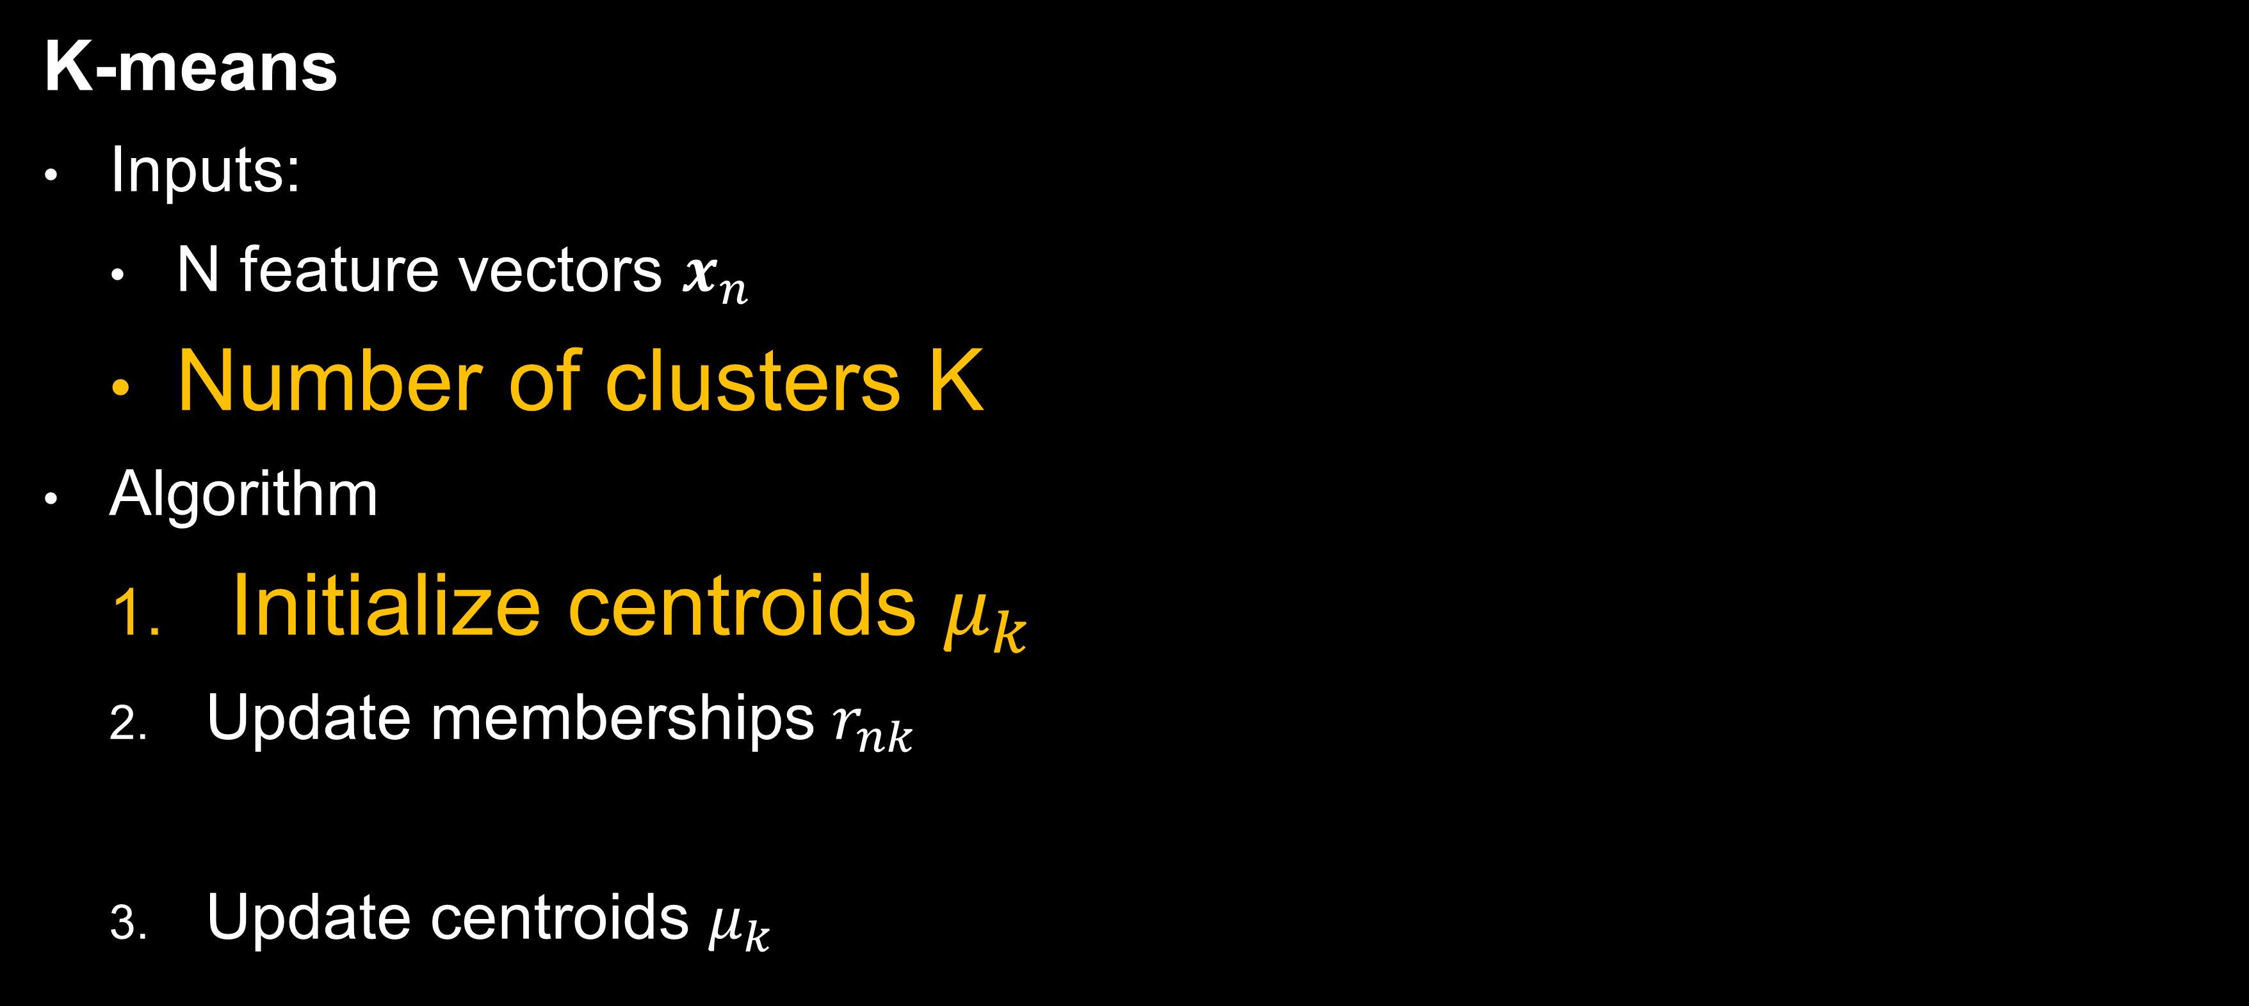

Unsupervised clustering
50.000 x 168
K-means
Inputs:
N feature vectors $x_{n}$
Number of clusters K
Algorithm
Initialize centroids $μ_{k}$
Update memberships $r_{nk}$
Update centroids $μ_{k}$
$$r_{nk}=\left\{\begin{aligned}1, k=\arg{\min{\{{||x_{n}−μ_{k}||}_{2}^{2}\}}} \\ 0, otherwise \end{aligned}\right.$$

Slide 20
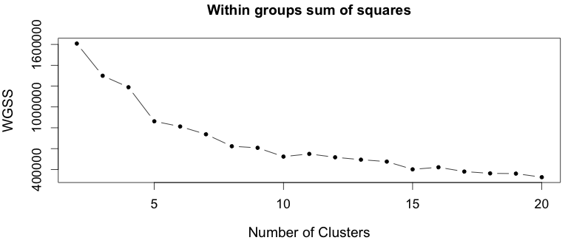


K-means
$$J= \sum_{n=1}^{N}{\sum_{k=1}^{K}{{r_{nk}||x_{n}−μ_{k}||}_{2}^{2}}}$$
$$r_{nk}=\left\{\begin{aligned}1, k=\arg{\min{\{{||x_{n}−μ_{k}||}_{2}^{2}\}}} \\ 0, otherwise \end{aligned}\right.$$

Slide 21
MLlib - Clustering
1.2.0
2014/12/18
K-means
1.5.0
2015/09/15
K-means
1.6.0
2016/01/04
K-means
Gaussian mixture
Power iteration allocation
Latent Dirichlet allocation (LDA)
Bisecting K-means
Streaming K-means
Gaussian mixture
Power iteration allocation
Latent Dirichlet allocation (LDA)
Streaming K-mean

Slide 22
MLlib - Clustering
import org.apache.spark.mllib.clustering.{KMeans, KMeansModel}
import org.apache.spark.mllib.linalg.Vectors
// Load and parse the data
// w1;w2;w3;w4;w5;…;w168 for each sensor
val data = sc.textFile("data/mllib/kmeans_data.txt")
val parsedData = data.map(s => Vectors.dense(s.split(‘;').map(_.toDouble))).cache()
// Cluster the data into classes using KMeans
val numClusters = 9
val numIterations = 1000
val clusters = KMeans.train(parsedData, numClusters, numIterations)
// Evaluate clustering by computing Within Set Sum of Squared Errors
val WSSSE = clusters.computeCost(parsedData)
println("Within Set Sum of Squared Errors = " + WSSSE)
// Save and load model
clusters.save(sc, "myModelPath")
val sameModel = KMeansModel.load(sc, "myModelPath")

Slide 23
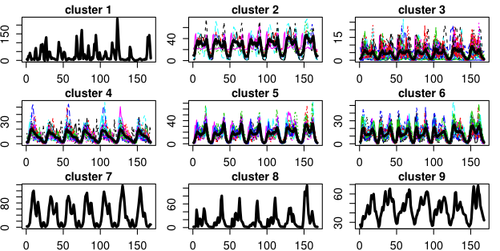
Unsupervised clustering

Slide 24
Unsupervised clustering
Possible causes of strange behaviors:
Irregular people (we have the right to be different!).
Water meter fault.
Fraud (false activity declared, manipulated water meter, bypass…).
…

Slide 25
Wrap up
Has been defined a general methodology to extract weekly patterns from AMR data and classify them using K-means.
The framework is based on Apache Spark. Thus, it’s totally independent of the data volume and scalable.
Applied on a 50k customers dataset ~14GigaBytes.
Segmentation of the consumers based on similarity.
Some outliers detected.
People can be different.

Slide 26

Thank you
@d1eg0_garc1a
diego.garcia@upc.edu

